Slide 1
Understanding Sales Trends for "Perfect Slice Pizza"
Welcome to the Sales Analysis Presentation for Perfect Slice Pizza!
By Rounak Pyne

Slide 2
Introduction and Objectives :
Introduction: In today's fast-paced and competitive market, staying ahead requires not just delicious pizzas but also a deep understanding of our sales data. Perfect Slice Pizza has approached us to gain insights into their sales trends, identify high-selling products, and develop a comprehensive sales dashboard and to analyze performance metrics for 2015 . The goal is to identify opportunities for further improvement.
Objectives : Our goal is to provide a detailed analysis of Perfect Slice Pizza's sales performance. By doing so, we aim to:
Uncover key sales trends and patterns
Identify the top-performing products
Develop a robust and interactive sales dashboard for ongoing monitoring and decision-making

Slide 3
Business Questions:
To derive meaningful insights from our pizza sales data, it is imperative to scrutinize key performance indicators. Specifically, we aim to compute the following metrics:
Total Revenue: The cumulative amount generated from all pizza orders.
Average Order Value: The mean expenditure per order, derived by dividing the total revenue by the number of orders.
Total Pizzas Sold: The aggregate count of all pizzas sold.
Total Orders: The overall number of orders received.
Average Pizzas Per Order: The mean number of pizzas sold per order, calculated by dividing the total number of pizzas sold by the total number of orders.

Slide 4
Understanding Key Charts to visualize:
We would like to visualize various aspects of our pizza sales data to gain insights and understand key trends. We have identified the following requirements for creating charts:
Daily Trend for Total Orders: Construct a bar chart depicting the daily trend of total orders over a specified timeframe. This visualization will enable us to discern patterns or fluctuations in order volumes on a day-to-day basis.
Hourly Trend for Total Orders: Develop a line chart illustrating the hourly trend of total orders throughout the day. This visualization will assist us in identifying peak hours and periods of heightened order activity.
Percentage of Sales by Pizza Category: Generate a pie chart displaying the distribution of sales across various pizza categories. This visualization will offer insights into the popularity of different pizza categories and their respective contributions to overall sales.

Slide 5
Understanding Key Charts to visualize:
Percentage of Sales by Pizza Size:
Generate a pie chart illustrating the proportion of sales attributed to different pizza sizes. This chart will help us understand customer preferences for pizza sizes and their impact on overall sales.
Total Pizzas Sold by Pizza Category:
Create a funnel chart representing the total number of pizzas sold for each pizza category. This visualization will allow us to compare the sales performance across various pizza categories.
Top 5 Best Sellers by Total Pizzas Sold:
Develop a bar chart highlighting the top 5 best-selling pizzas based on the total number of pizzas sold. This chart will help us identify the most popular pizza options.
Bottom 5 Worst Sellers by Total Pizzas Sold:
Construct a bar chart showcasing the bottom 5 worst-selling pizzas based on the total number of pizzas sold. This chart will enable us to identify underperforming or less popular pizza options.

Slide 6
Scope: This presentation will cover the following aspects:
Sales Trends Analysis:
Understanding overall sales performance over time
Identifying seasonal patterns and peak sales periods
High-Selling Product Identification:
Analyzing product sales to highlight top sellers
Understanding customer preferences and product popularity
Sales Dashboard Development:
Designing a user-friendly sales dashboard
Enabling real-time tracking and visualization of key sales metrics

Slide 7
Software Used:
MS Office / Excel : Version 2021
MS Office / PowerPoint : Version 2021
MySQL Workbench: Version 8.0

Slide 8
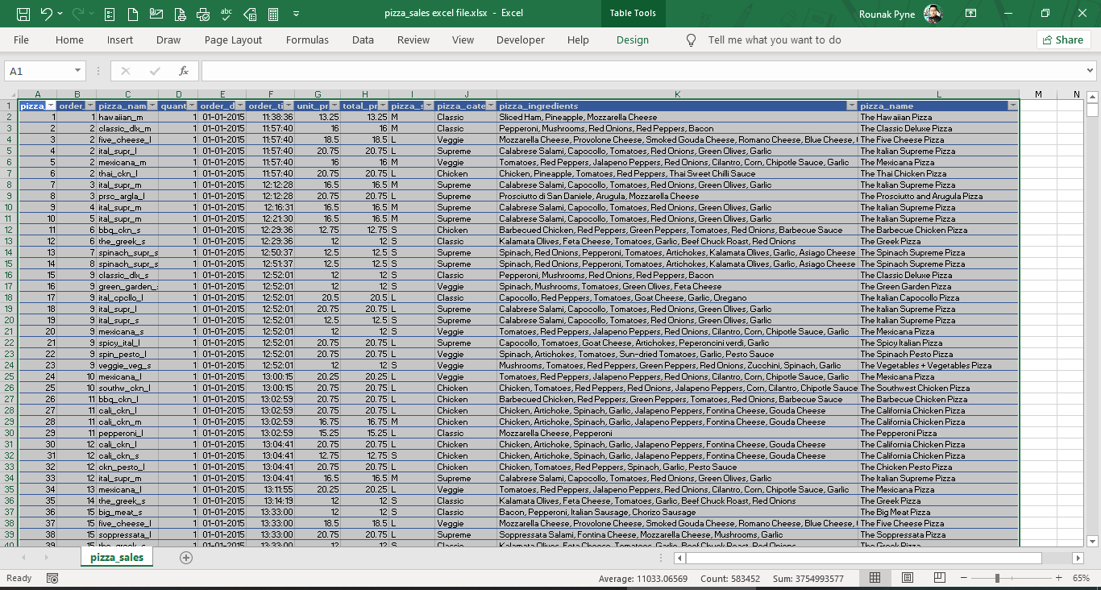
Data Snippet:

Slide 9
Key Performance Indicators findings:

Slide 10
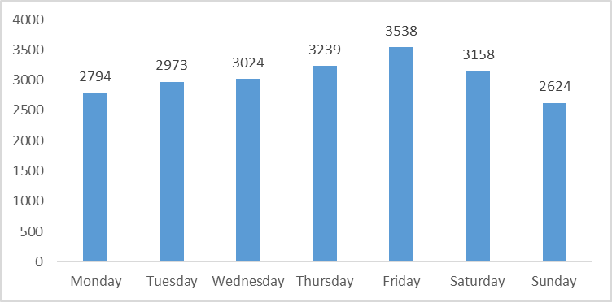
Daily Trends for total orders placed:

Slide 11
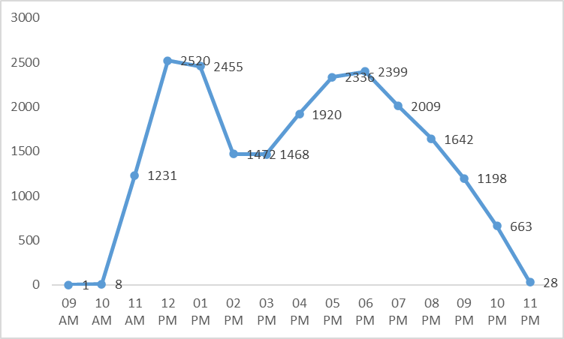
Hourly Trends for total orders placed:

Slide 12
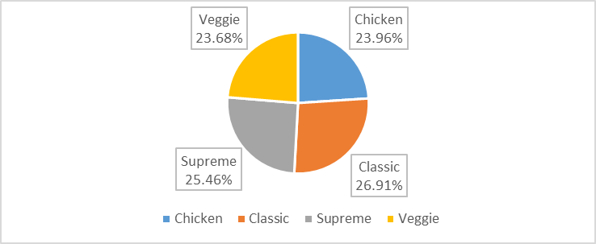
Percentage of Sales by Pizza Category:

Slide 13
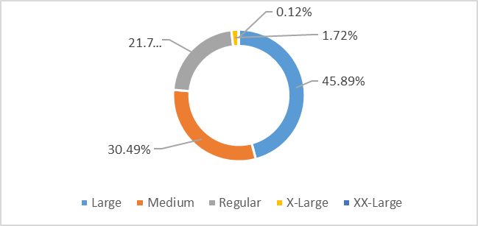
Percentage of Sales by Pizza Size:

Slide 14
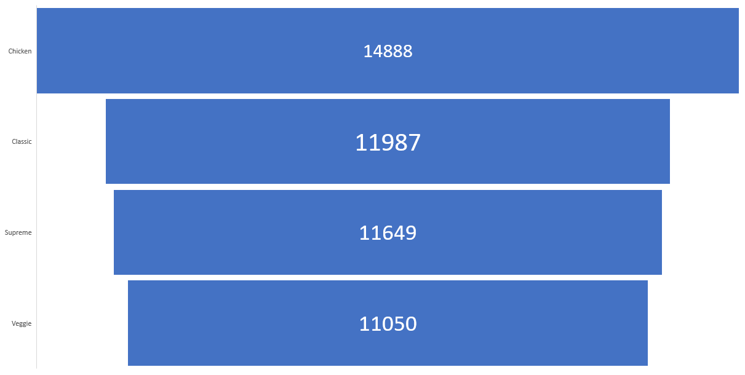
Percentage of Sales by Pizza Size:

Slide 15
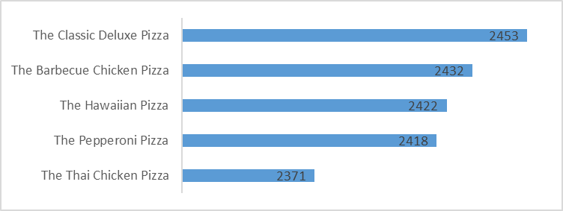
Top 5 Best Sellers by Total Pizzas Sold:

Slide 16
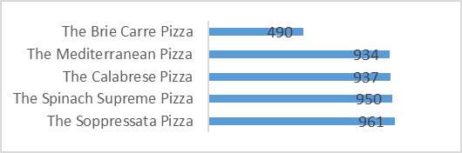
Bottom 5 Best Sellers by Total Pizzas Sold:

Slide 17
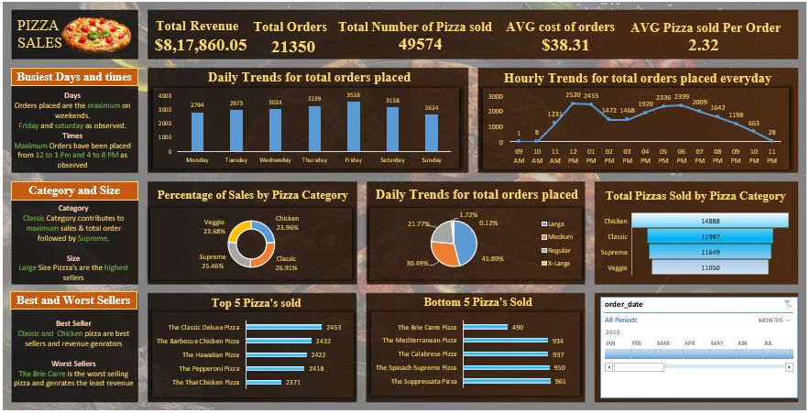
Final Dashboard:

Slide 18
Final Conclusion and Summary:
Busiest Days and times:
Days: Orders placed are the maximum on weekends. Friday and Saturday as observed.
Times: Maximum Orders have been placed from 12 to 1 Pm and 4 to 8 PM as observed.
Category and Size:
Category: Classic Category contributes to maximum sales & total order followed by Supreme.
Size: Large Size Pizza's are the highest sellers.
Best and Worst Sellers:
Best Seller: Classic and Chicken pizza are best sellers and revenue generators
Worst Sellers: The Brie Carre is the worst selling pizza and generates the least revenue

Slide 19
Why It Matters:
By harnessing the power of data, Perfect Slice Pizza can:
Optimize inventory and supply chain management
Tailor marketing strategies to boost sales
Enhance customer satisfaction by focusing on popular products
Make informed decisions to drive business growth

